Slide 1
Results from Noise Amplification in VQE Optimized Circuit (4.1)
Noise Amplified by Randomized addition of pairs of similar gates
Meeting with Professor Schnetzer and Rikab
August 10, 2020

Slide 2
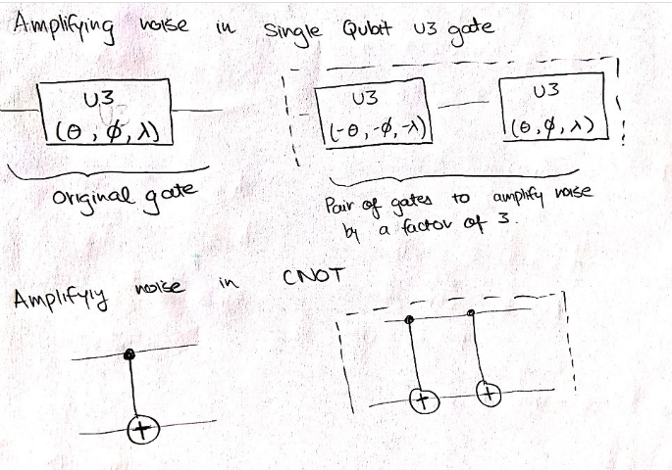

Noise Amplification Procedure
Correction:
$$U3^{−1}\left(θ, φ, λ\right)$$
$$=$$
$$U3(−θ, −π−λ,−π−φ)$$

Slide 3
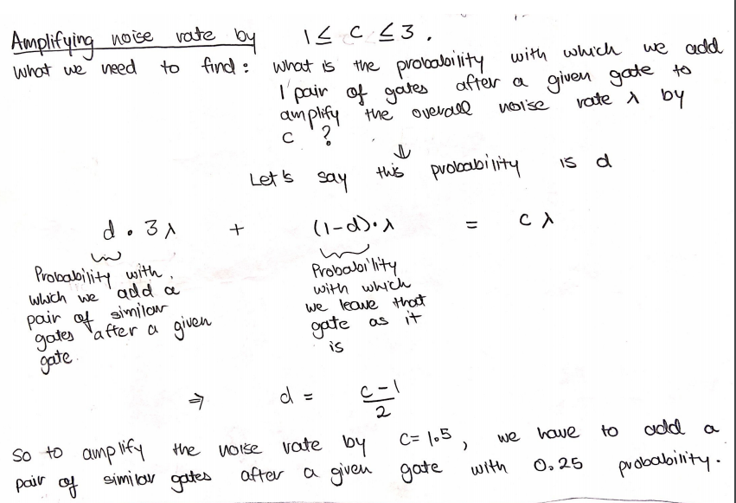
Noise Amplification Rate $≠$Probability of adding a pair of gates

Slide 4
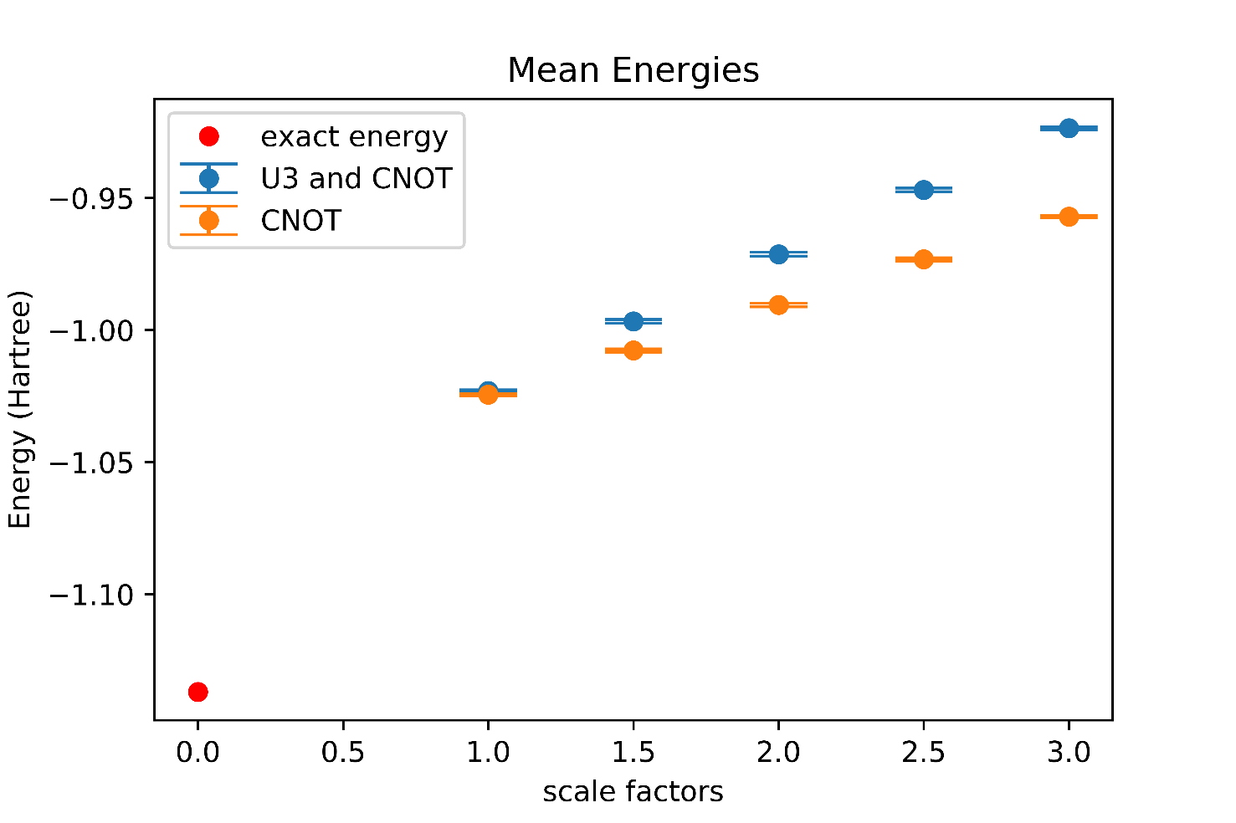
Adding a pair of gates randomly
London Noise Simulator
1000 samples

Slide 5
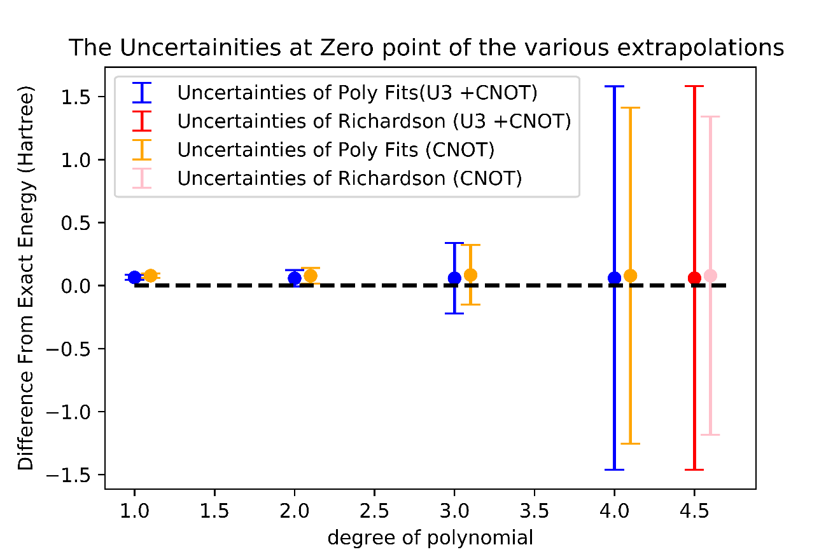
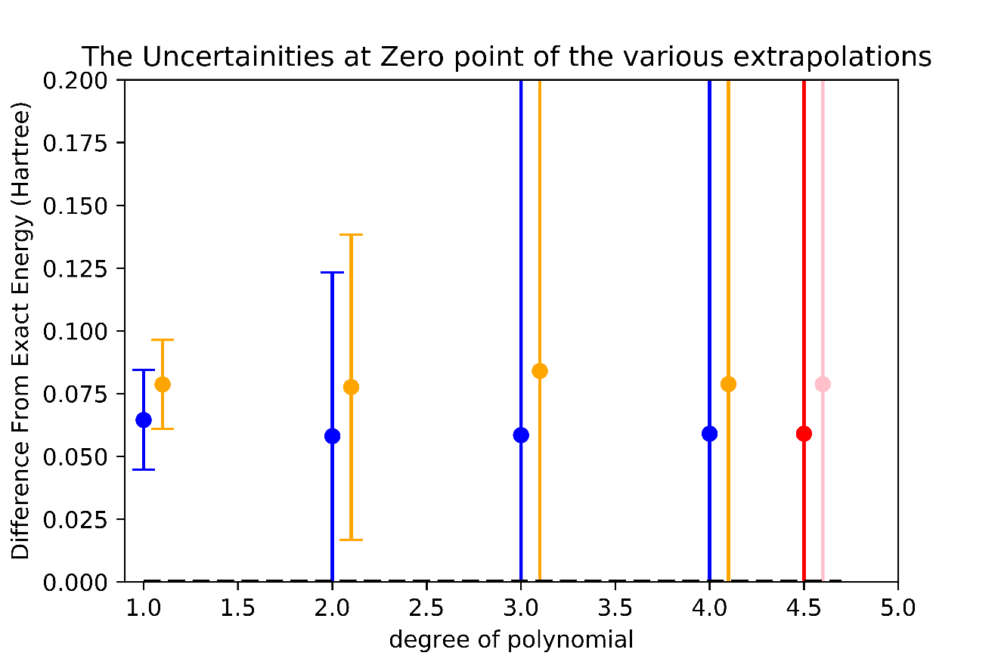
Adding a pair of gates randomly
Extrapolation

Slide 6
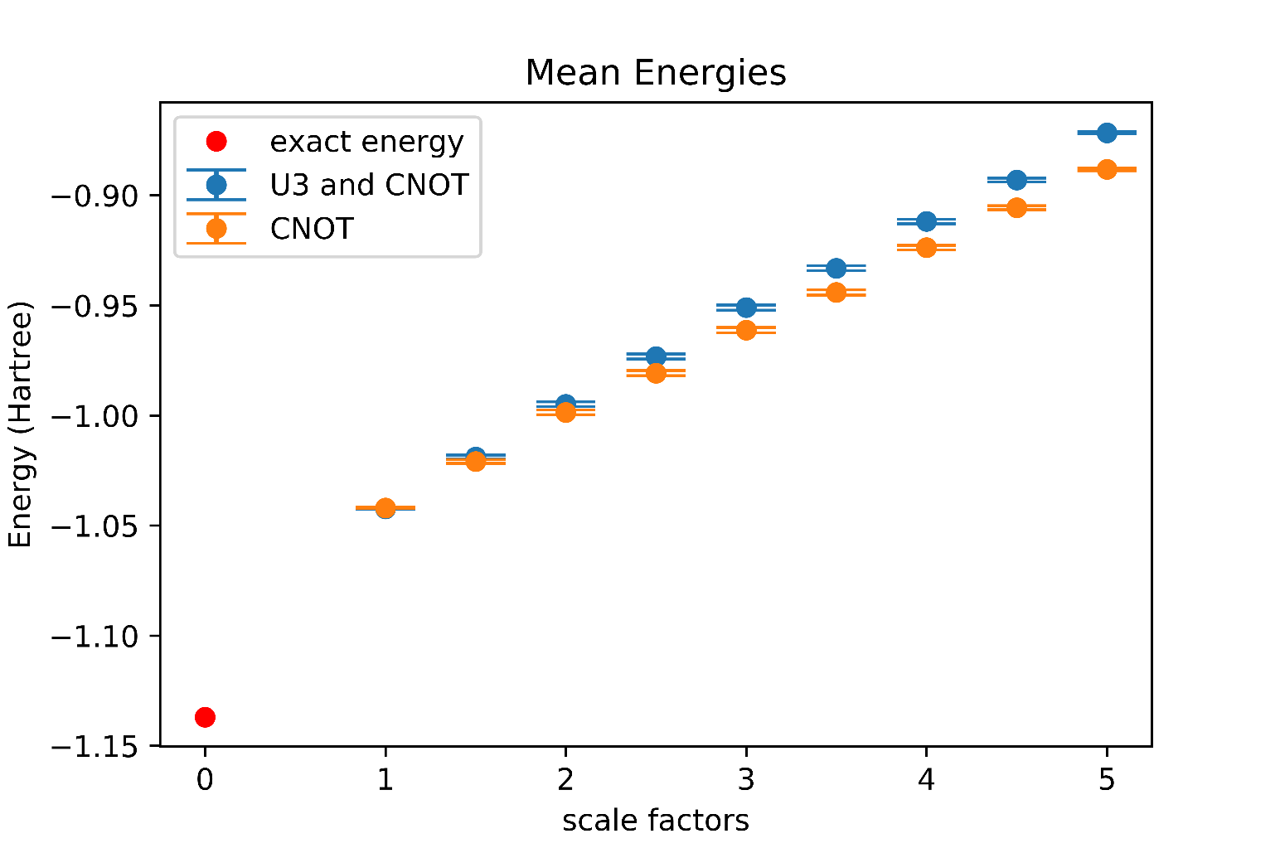
Adding 2 pairs of gates randomly
London Noise Simulator
1000 samples

Slide 7
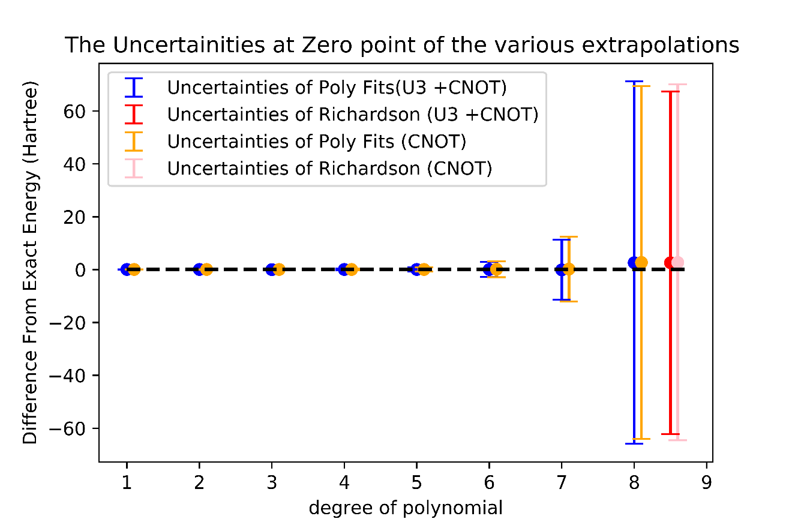
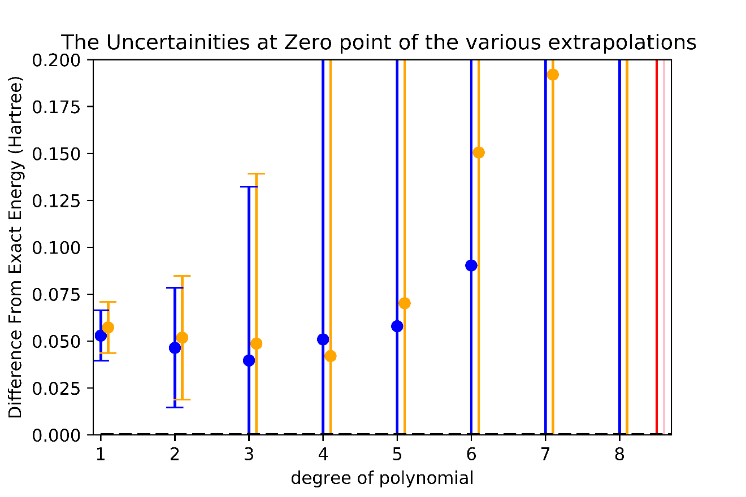
Adding 2 pairs of gates randomly
Extrapolation

